Slide 1

English session for Hitan Platform prepared by
Nabeel Badawi

Slide 2
What’s your name?
My name’s ………….
I’m ………………..
It’s…………………..

Slide 3
What’s your major?
It’s B.A. in………
Bachelor of Arts
It’s B.Sc. in …………
Bachelor of Science

Slide 4
Some English letters with different pronunciation in special combinations
Cell --- Can
Goal---- Ginger
Sit ----- Set
Think -------- Sink With---------Wiz
Ship-----Chip
Warm---------Worm
Act-----Cat----Cake----Call----Car (Alt)

Slide 5
B VS P

Slide 6
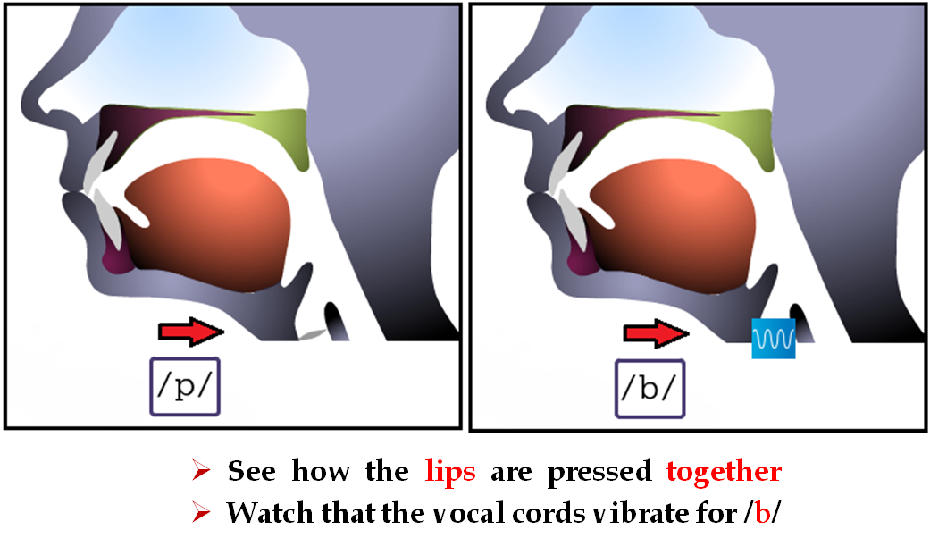

Slide 7
P
pot, pet, pull, pop, paper, step, stop
cap, cup
happy, apple
spot, speak, lamp, stamp
please, praise
prime, appear, approve, April
people, purple, popular
pepper, pumpkin
prepare, propose, properly
perpetual, participate

Slide 8
B
bee, buy, but, because, baby, the Bible
bread, brick, blue, black
able, table, cable, label, stable
trouble, bubble, library, bribe
blueberry, blackberry
brilliant, abnormal, combine, combination
debatable, barbeque, butter, beans

Slide 9
B & P
public, publication, September
proverb, capable
probation, prohibition

Slide 10
السبت
بــــــــ
B P

Slide 11
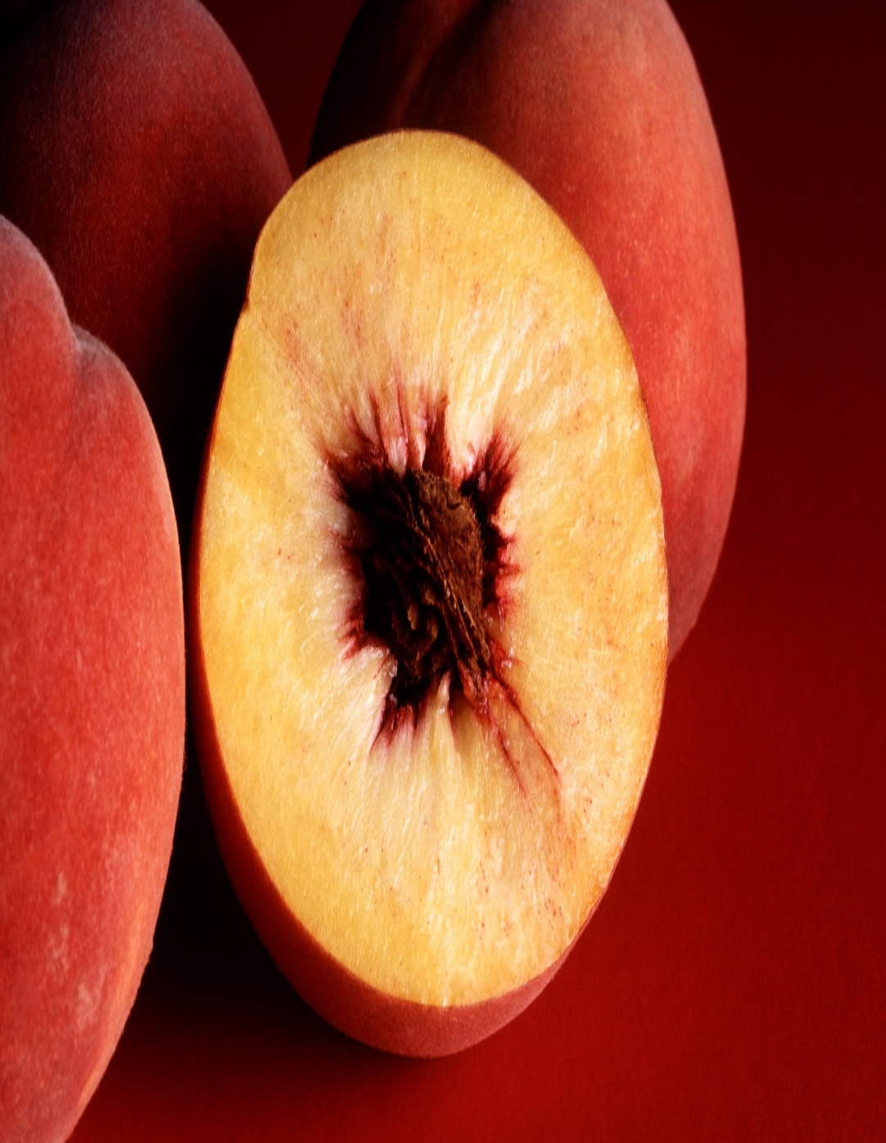

Peach
Beach

Slide 12
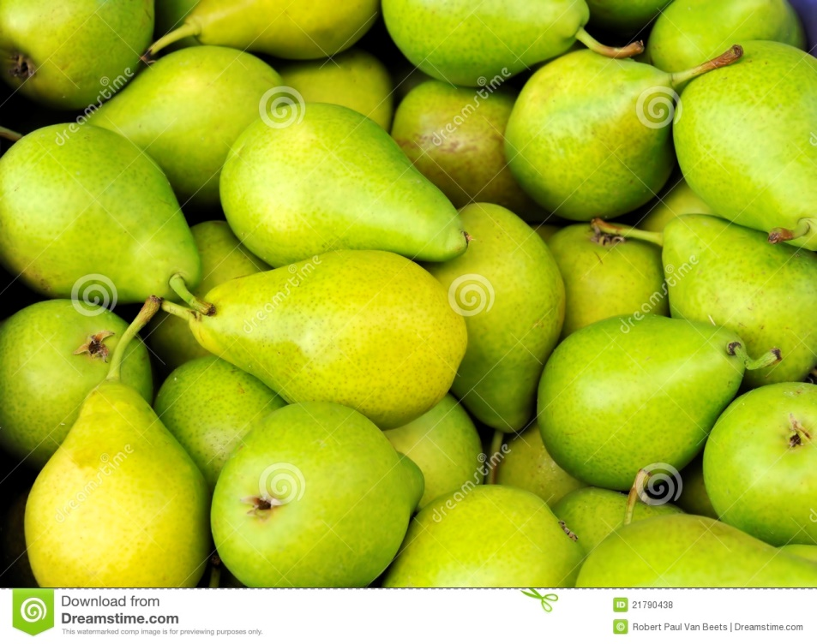

Pear
Bear

Slide 13
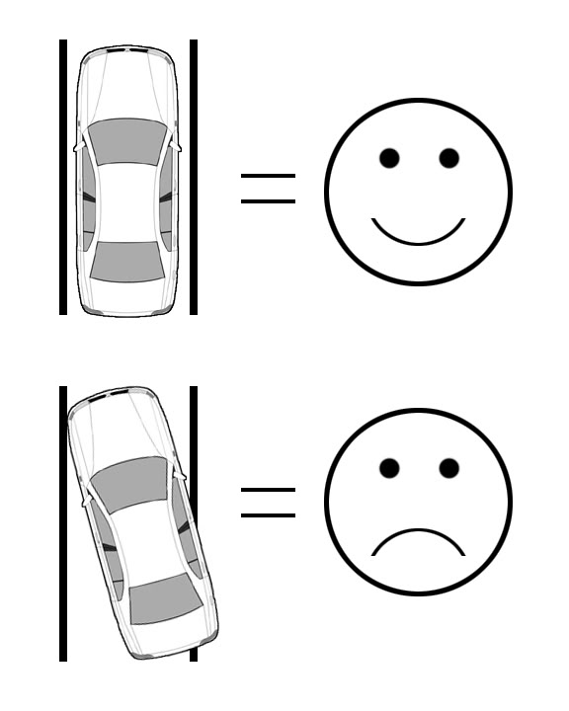

Park
Bark

Slide 14
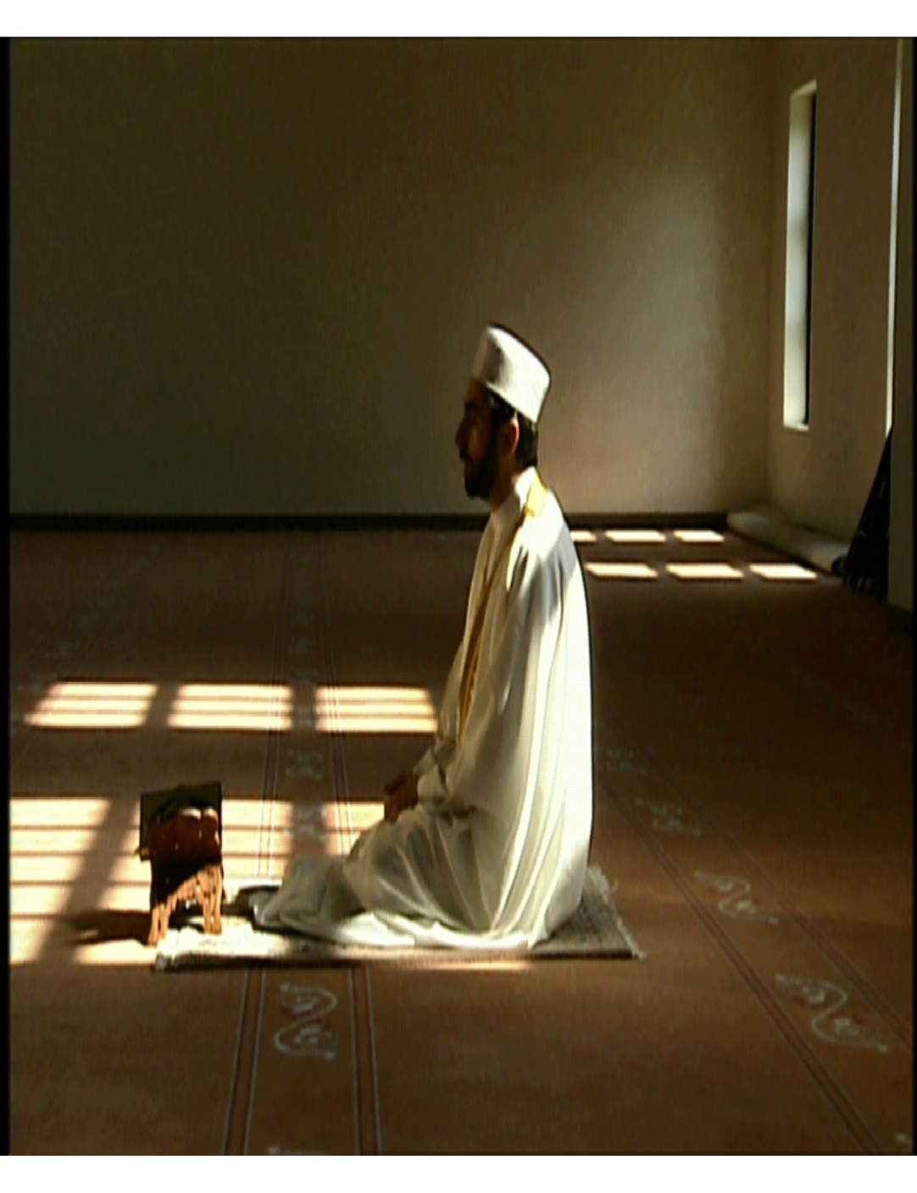
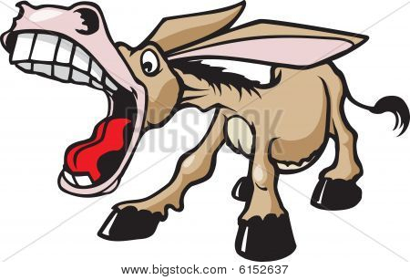
Pray
Bray

Slide 15
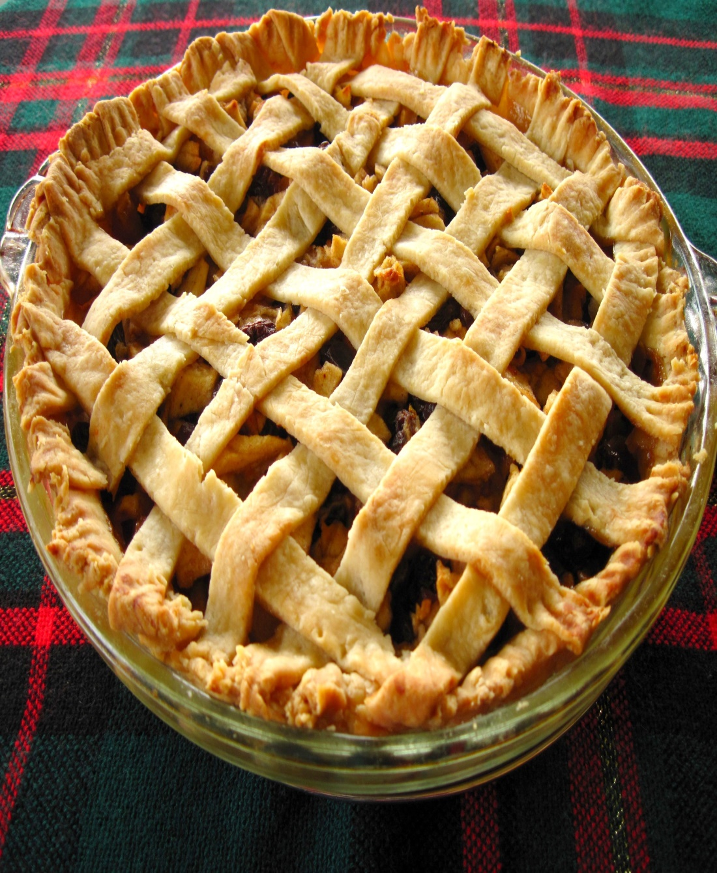
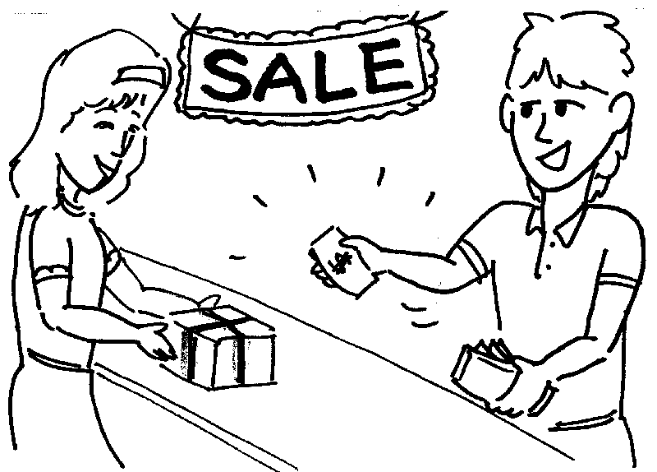
Pie
Buy

Slide 16
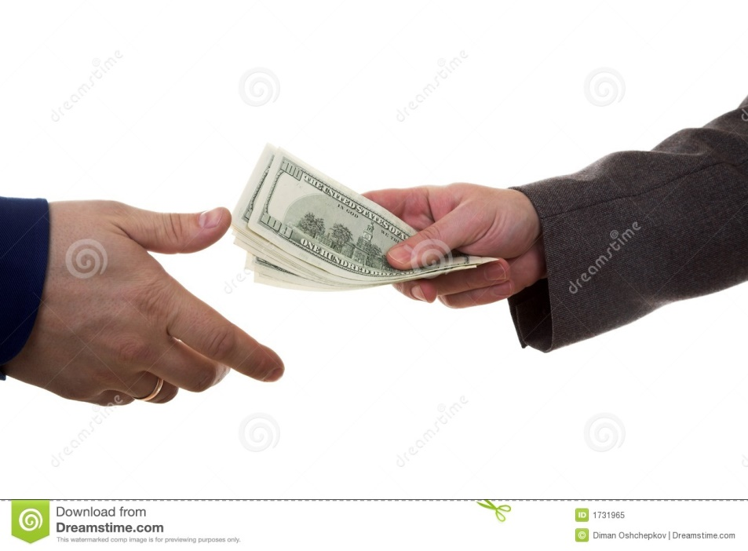
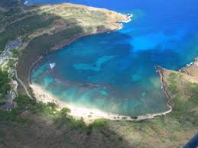
Pay
Bay

Slide 17
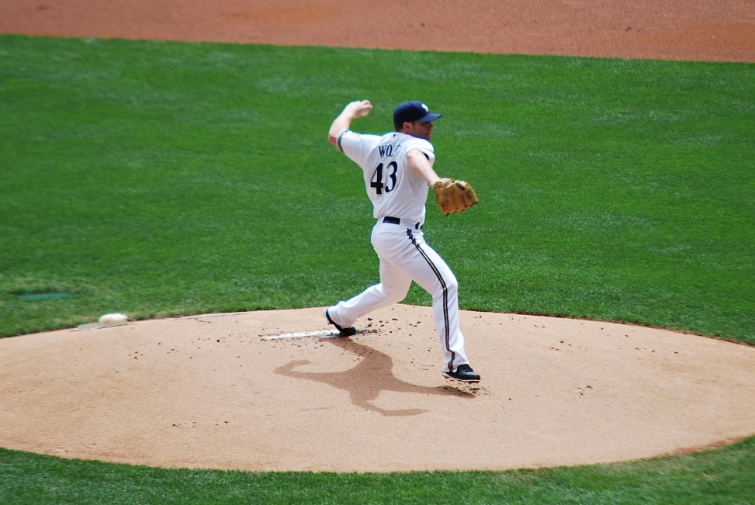

Pitch
Bitch

Slide 18
Relationship between language and culture
Language - means of communications
Concomitantly
Culture - lifestyle
دبلوم دبلون
بنزينة بنزيمة
Jack – Jacket
Juice
project

